Slide 1
LAST LAYER RE-TRAINING
Parsa Sharifi

Slide 2
LAST LAYER RE-TRAINING IS SUFFICIENT FOR ROBUSTNESS TO SPURIOUS CORRELATIONS

Slide 3
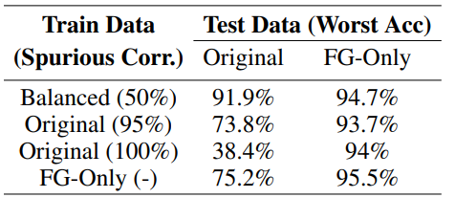
Train ERM on each of the variations of the data
Still can learn core features!
models make better predictions on the FG-Only
as well as the models trained on the data without spurious correlations

Slide 4
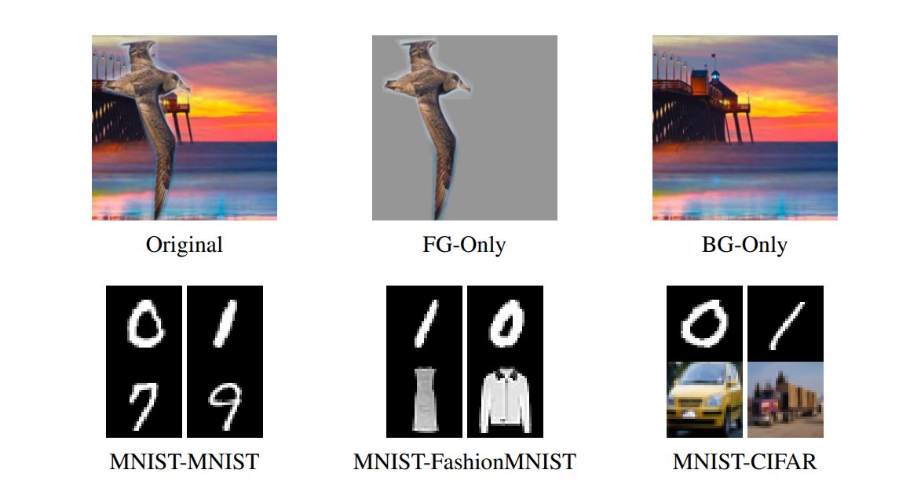
Extreme simplicity bias
Top half of the images as a spurious feature
Bottom half as the core feature

Slide 5
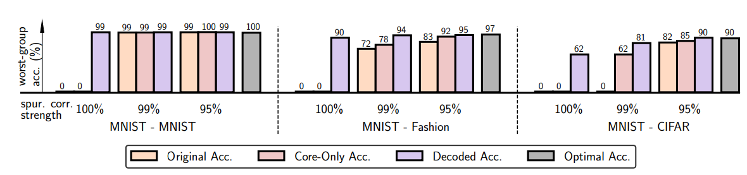

Slide 6
when the spurious features are perfectly correlated with the target, the model relies just on the simple spurious feature

Slide 8
with 99% and 95% spurious correlation levels on train, we observe that models learned the core features well
Optimal accuracy, which is the accuracy of a model trained and evaluated on the Core-Only data(upper bound)

Slide 10
Decoded accuracy: latent representation, we evaluate the decoded accuracy
Using regression

Slide 12
The strength of the spurious correlation is lower than 100%
The difference in complexity between the core and spurious features is not as stark as on MNIST-CIFAR
the core feature can be decoded from the learned embeddings with high accuracy

Slide 13
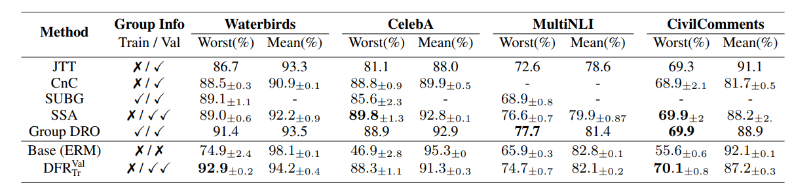

Slide 14
Weight the group accuracies according to their prevalence in the training data for mean accuracy
The Group Info column shows whether group labels are available to the methods on train and validation datasets

Slide 16
DFRVal Tr , where we use a group-balanced subset of the data
Train logistic regression 10 times using different random balanced subsets of the data and average the weights of the learned models.
Use held-out data for retraining the last layer

Slide 17
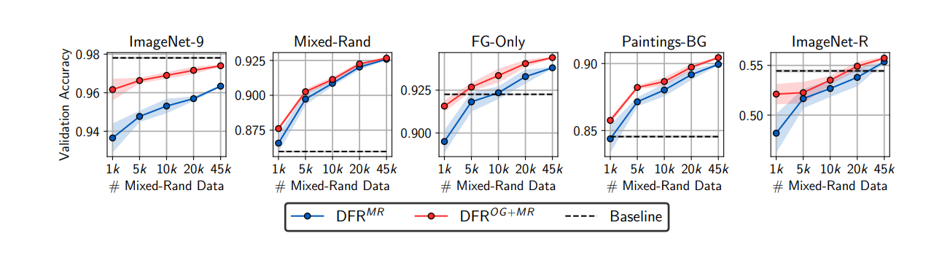

Slide 18
Reducing background reliance does not provide a big improvement.

Slide 19
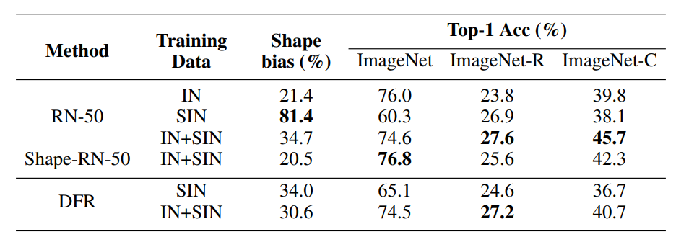

Slide 20
Annotation-Free Group Robustness via Loss-Based Resampling

Slide 21
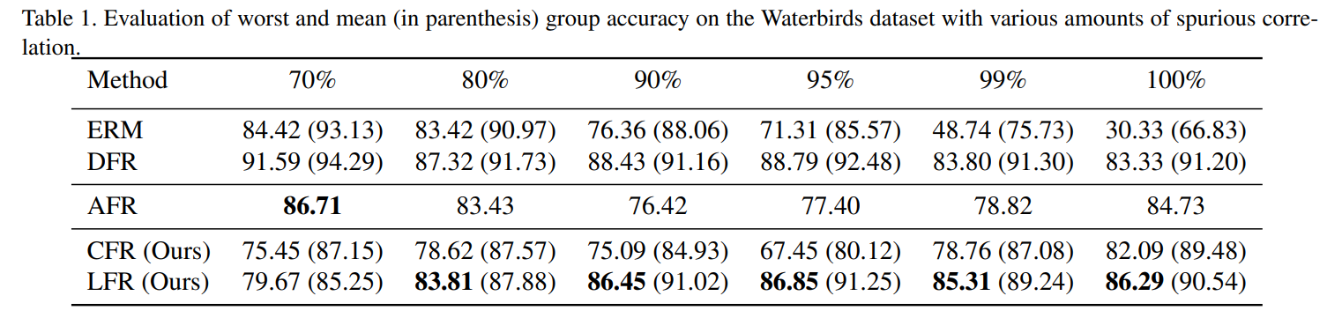

Slide 22
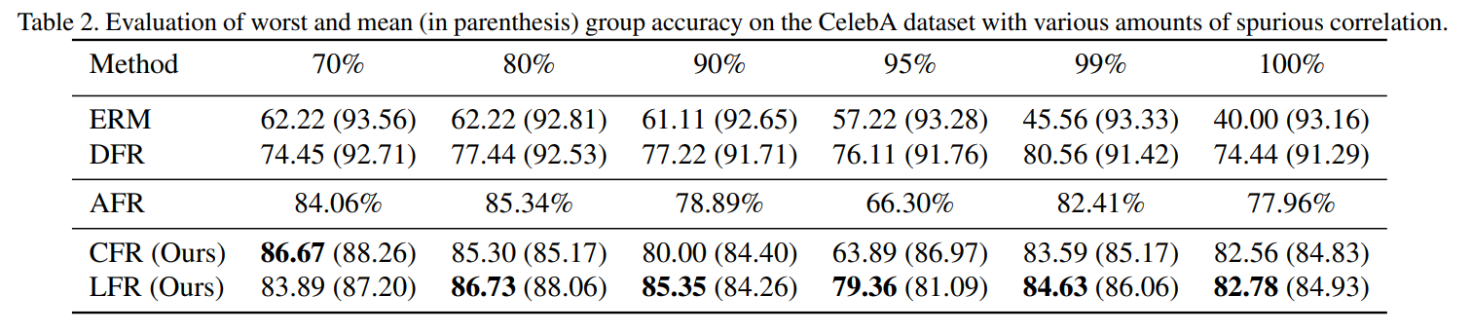

Slide 23
Spurious correlation is high enough, LFR outperforms the AFR and DFR.
Classification-based Feature Re-weighting (CFR)
Spurious correlation is low, the impact of loss-based selection diminishes.
LFR selects an equal number of samples from both the majority and minority but AFR does not

Slide 24
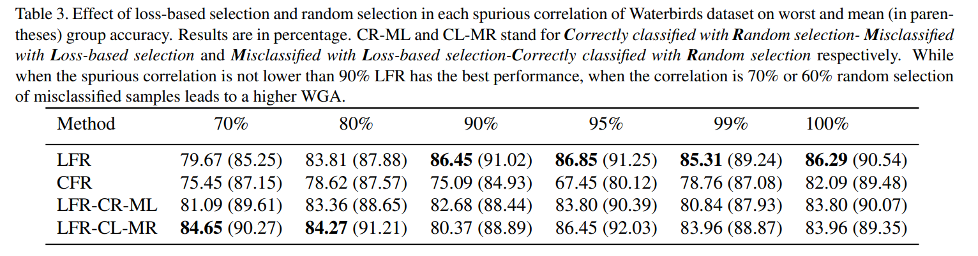

Slide 25
Ideas!!

Slide 26
Using contrastive methods?
Lowering the correlation
Knowledge distillation?
To get the base of model and retraining it!

